Slide 1

NRHEG Student Resources
We are STILL here for you...just in a different sort of way :)

Slide 2

We are here for you and would love to connect!
Secondary School Counselor | Liz Stiernagle | lstiernagle@nrheg.k12.mn.us | 507.417.2608
District School Social Worker | Brooke Krohn | bkrohn@nrheg.k12.mn.us | 507.417.2645
Elementary Family Service Coordinator | Bre Bethke | bbethke@nrheg.k12.mn.us | 507.416.2139
If you call us and we don’t answer, please leave us a message and we will call you back! The number we call you back from may not be the school’s number, but rather our google voice number.

Slide 3
Other school contacts...
Elementary Principal | Doug Anderson | danderson@nrheg.k12.mn.us
Secondary Principal | David Bunn | dbunn@nrheg.k12.mn.us
School Nurse | Carrie Petsinger | cpetsinger@nrheg.k21.mn

Slide 4
Your social worker and school counselor are available via Google Meet, phone, or by email!
Email them to set up an appointment! :)

Slide 5
If you need immediate assistance:
EMERGENCY: DIAL 911
National Suicide Prevention Lifeline: 1-800-273-TALK (8255) free 24-hour help
National Suicide Crisis: 1-800-784-2433 (24 hour line)
South Central Mobile Crisis Line: 1-877-399-3040 (24 hour line)
24 Hour Adult Mental Health Crisis Line: 1-800-233-9929
United Way First Call for Help: 1-800-543-7709

Slide 6
Resources for Parents and Guardians
Talking to Children about Covid-19
https://www.cdc.gov/coronavirus/2019-ncov/community/schools-childcare/talking-with-children.html
Mental Health and Coping during Covid-19
https://www.cdc.gov/coronavirus/2019-ncov/prepare/managing-stress-anxiety.html
Covid-19 Bilingual resources (Covid-19 recursos bilingües)
https://www.colorincolorado.org/coronavirus
Staying Active Indoors
https://whatmomslove.com/kids/active-indoor-games-activities-for-kids-to-burn-energy/
Calming Activities for children of all ages
https://gozen.com/50-calm-down-ideas-to-try-with-kids-of-all-ages/

Slide 7
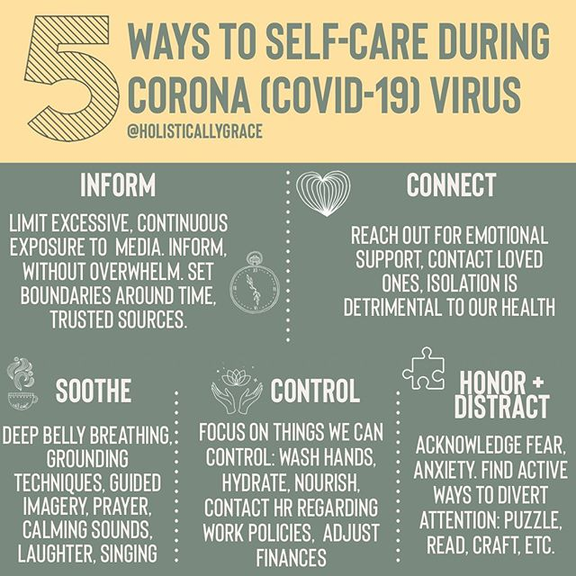
We could all use a little self-care now and then!

Slide 8
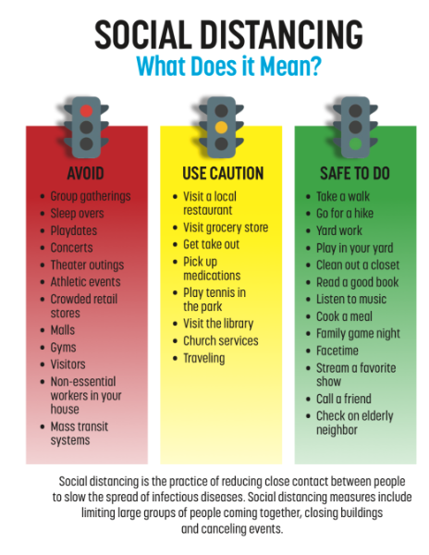
What is social distancing?
This can help you decide what activities are safe to do while we need to practice social distancing.
This means be PHYSICALLY distant from others, but you can still be social in other ways.
Social distancing is the practice of reducing close contact between people to slow the spread of infections or diseases. Social distancing measures include limiting large groups of people coming together, closing buildings and cancelling events.

Slide 9
Let’s make sure we are staying accountable for what we CAN vs. what we CANNOT control...

Slide 10
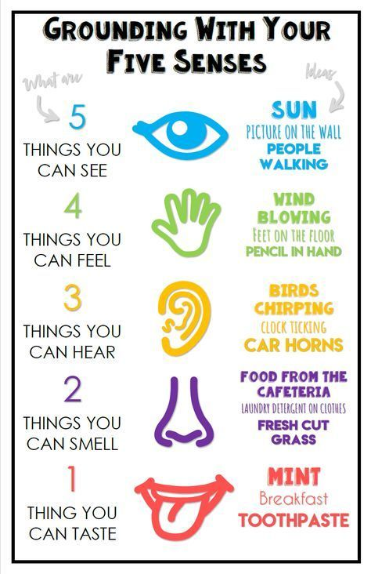
Mindfulness is a powerful tool. We can spend a lot of our time worrying about the past or worrying about the future.
Find time throughout your day to be in the PRESENT MOMENT
Let Liz, Brooke or Bre know if you would like any other mindfulness ideas! Look for more tips on mindfulness to be posted by us on the school website!

Slide 11

Remember...
Take care of yourself
Take care of your family
Do something kind for someone else
Reach out for help when you need it
Be a nice human
We are all in this together and we will get through this together!

